Slide 1
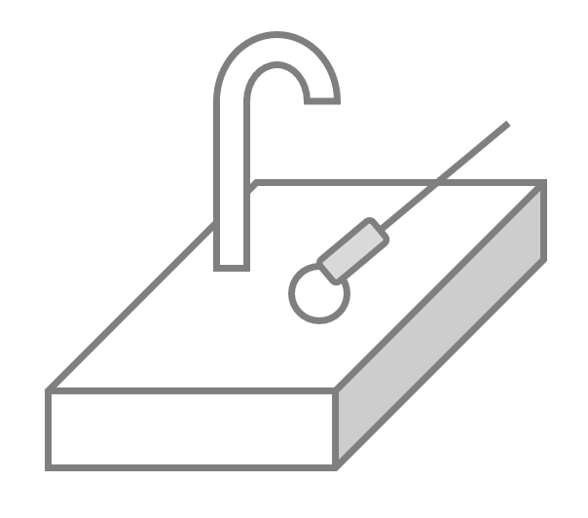
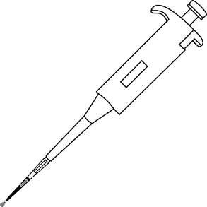
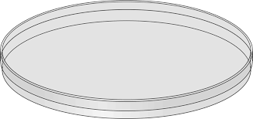
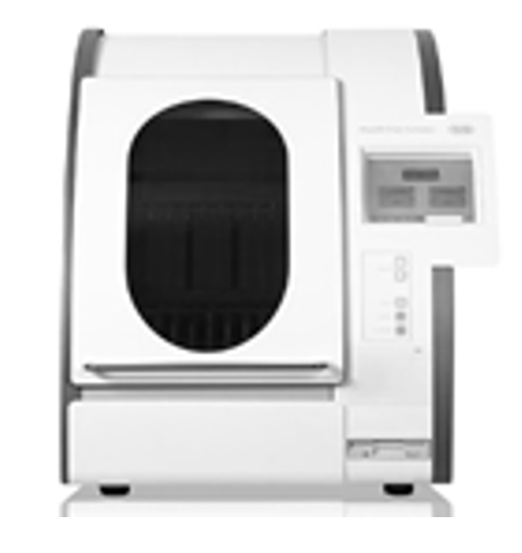
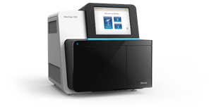
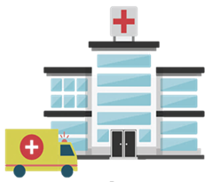
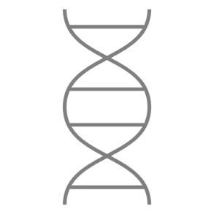
Figure 1
Environmental samples
(n=40)
Clinical isolates
(n=10)
Day 1
Day 1
Samples
collected
Swabs plated in selective media
Pure cultures sent to research laboratory
Days 2, 3 and 4
Isolation of colonies suggestive of CRKP
DNA extraction
48 hours
DNA sequencing
Genomic analysis
Results sent to hospital

